Slide 1
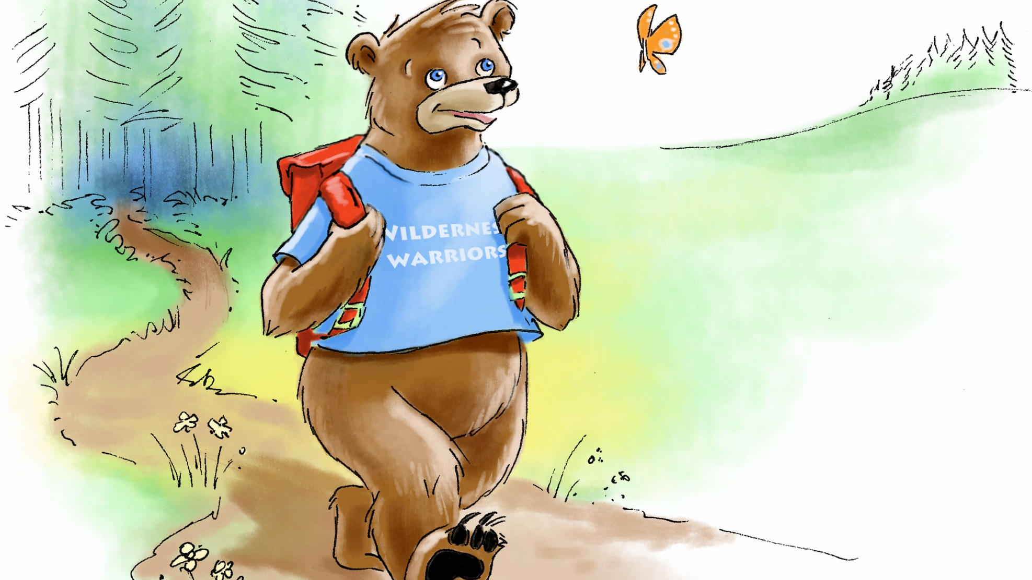
FINLAY THE FIRST AID BEAR
The Dare to Golden Mountain (Book One)
Interactive Quiz

Slide 2


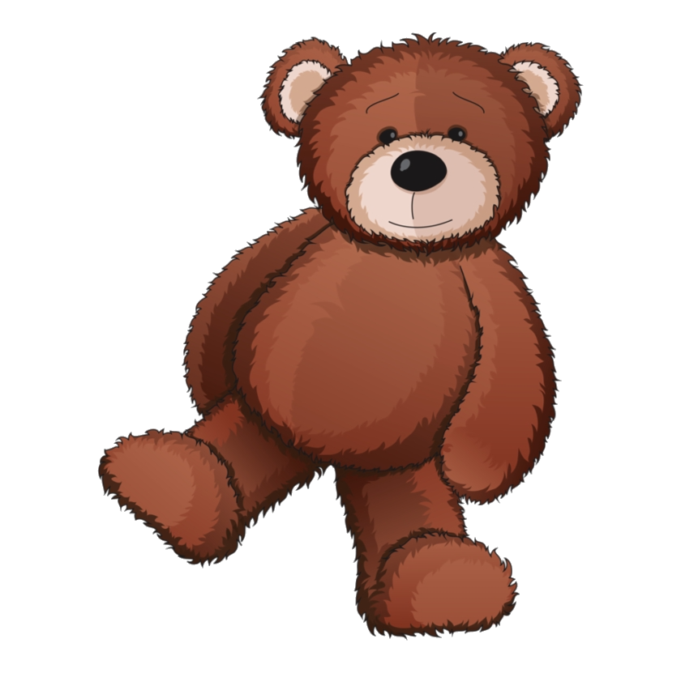

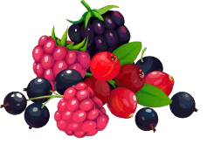


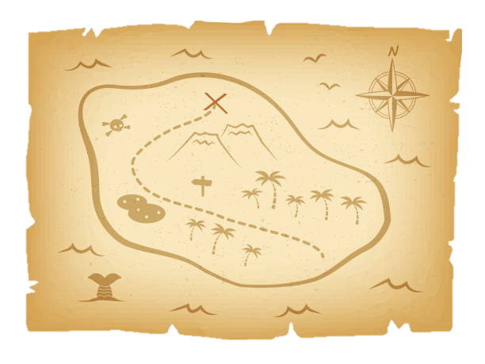
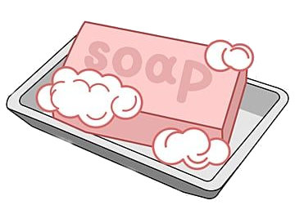
What should Finlay put in his backpack to go to the Golden Mountain?
Click on the pictures to see if you are right!
First aid kit
Berries
Teddy bear
Compass
Water bottle
Soap
Games
Honey
Map of the woods
There are 7 right answers!
Click HERE when you have all 7 items right!

Slide 3
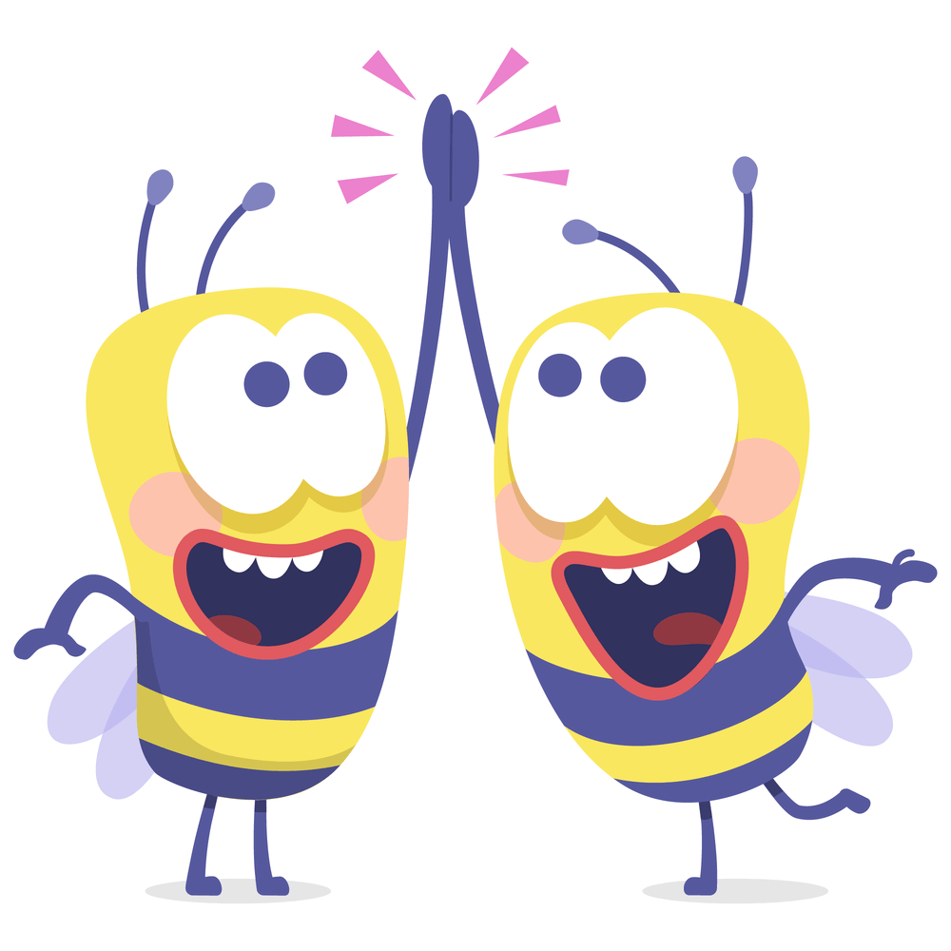
That’s right!!
This item is going to help Finlay to do First Aid or if he gets lost in the woods.
Back to Question

Slide 4
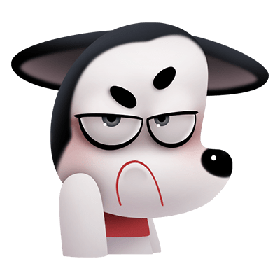
Ahhh nuggets!
That’s not quite right..
Finlay would love to take this with him but it is not going to help him on his trip if he needs to help someone or if he gets lost on his adventure
Back to Question

Slide 5
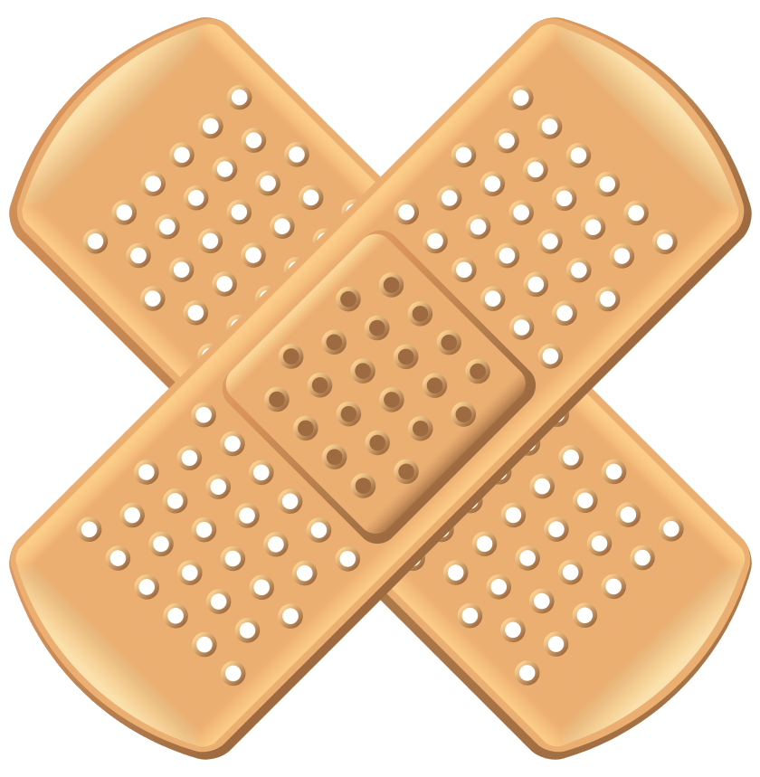
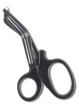


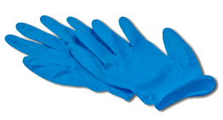
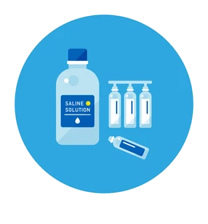
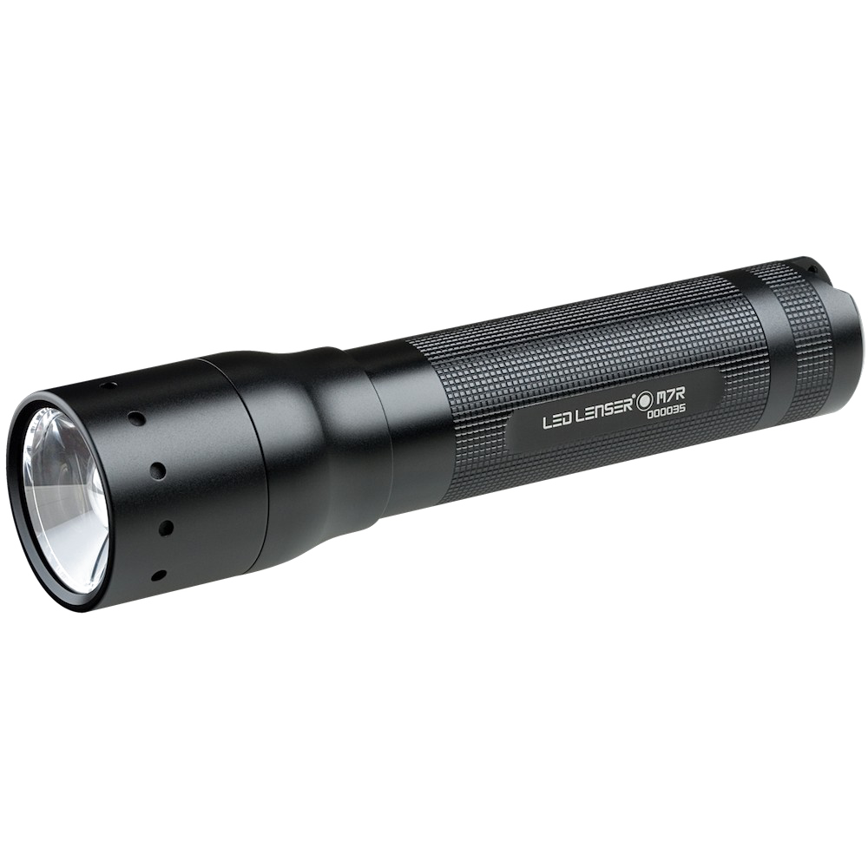

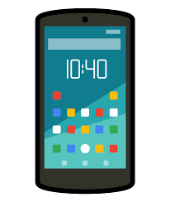


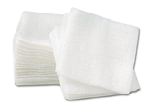

What are items in Finlay’s First Aid kit?
Click on the pictures to see if you are right!
Bandaids
Scissors
Bandages
Gloves
Ice pack
Torch
Saline
Resuscitation mask
Lollies
Phone
Tape
Wound dressings
There are 7 right answers!
Click HERE when you have all 7 items right!

Slide 6
That’s right!!
This item is important if Finlay and Evee need to help someone who has hurt themselves
Back to Question

Slide 7
Ahhh nuggets!
That’s not quite right..
This item is not in Finlay’s first aid kit.
Back to Question

Slide 8
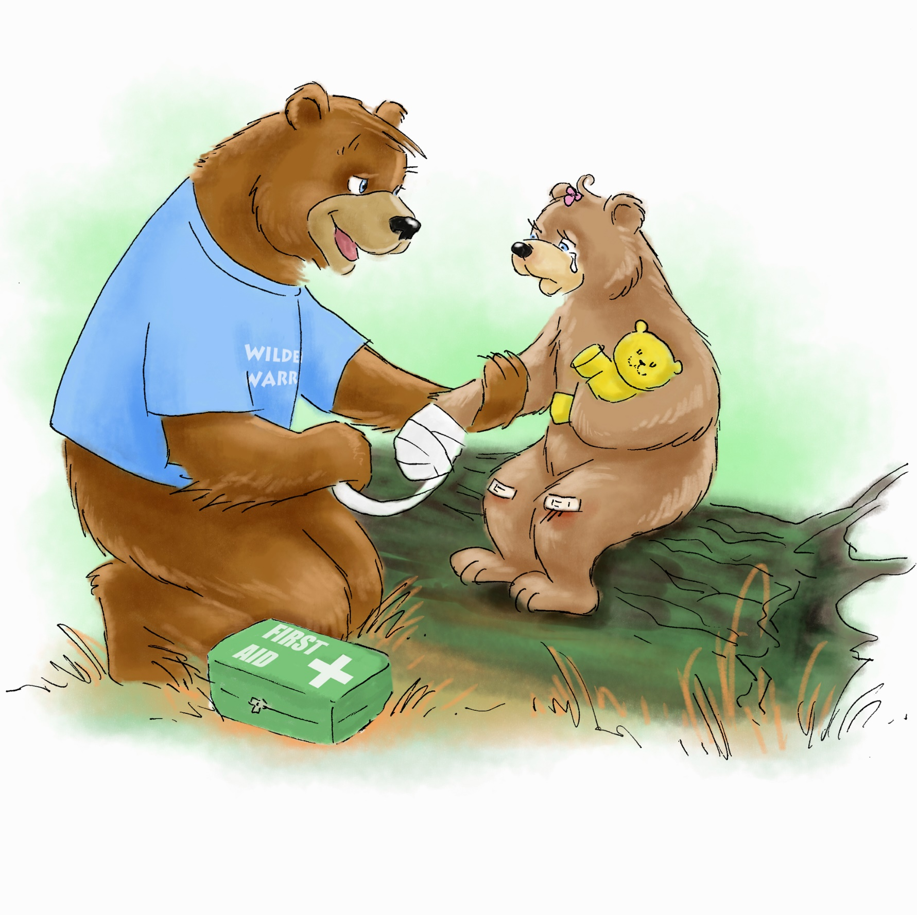
Oh NO!!! Poor Evee has tripped and hurt herself!
(insert picture of Evee with her sores and grazes)
Evee has a cut on her paw and grazes on her knees
we can do a drag and drop type thing – e.g. place the correct first aid items to treat Evee’s cut and grazes

Slide 9
How did Finlay help Frederick with his Nose Bleed

Slide 10
How did Finlay help Frederick with his Nose Bleed

Slide 11
Poor Finlay has a burn on his foot
How to treat burns quiz

Slide 12
Which is the best drink to have when you are feeling hot and thirsty

Slide 13
Little Evee has a blister on her foot

Slide 14
How to Call for Help on the Phone – Call, Say, Wait, Stay

Slide 15
How to wash hands like Finlay and Evee

Slide 16
Eating and drinking for energy – what would bears eat? What should you have?

Slide 17
Feeling upset and worried

Slide 18
Evee’s night time song

